Slide 1
Sentiment Analysis On U.S. Telecom Companies

Slide 2

Hello!
I am Rohin Sandhu
I am here to present my project : “Sentiment Analysis on U.S. Telecom Companies”
You can find me at @white_devil_61

Slide 3
Roadmap Of Presentaion
Conclusion & Future Scope
Introduction Of Project
Project Report Work
1
3
5
2
4
6
Technologies & Tools Used
User Guide
Doubt Clearance Zone

Slide 4
With public sentiments, nothing can Fail. Without It, Nothng can Succeed.
~ Abraham Lincon

Slide 5
Technologies Used
1
In this module we will discuss about various Tools & Technologies used while making this project.

Slide 6
Technologies Used In Project
Twitter & Its API
Twitter is an online news & Social Networking site where people Communicate in Short Messages called Tweets.
We will take help of Tweepy module of Python to collect various tweets. We will use these tweets for Sentiment Analysis.
Python & Its Libraries
Python is an Interpreted, Object-Oriented, high-level programming language with dynamic semantics. Library is simply a collection of codes or modules of codes.
We will use various libraries like: Pandas, NumPy, TextBlob, Tweepy, CV & RE
Microsoft Excel
Microsoft Excel is used for calculation or computation capabilities, Graphing Tools, Pivot Tables, and a macro programming language called Visual Basic for Applications.
It is one of the most popular applications for Data Analysis.

Slide 7
Project Report Work
2
In this module we will discuss about Objectives, Methodologies & Hardware & Software Requirements of the project.

Slide 8
Project Report Work
Objectives
The objectives of Sentiment Analysis that are associated with this project are :
To mine the Public Opinion.
To find the correlation between the Moods of public.
To help the investors to identify the intrinsic worth of a security even before investing in it.
To Show it is indeed possible to have sense of where the market will go
Hardware & Software Requirements
Minimum Software/Hardware requirements that are needed for the project:
Processor: Intel ® Core ™ i5-6440HQ CPU @ 2.60GHz 2.59GHz
Installed Memory (RAM): 8.00 GB (7.64 GB Usable)
System Type: 64-bit Operating System
Back-End Data Service Provider: Twitter 9.4.10
Operating System: Windows 10
Front-end Tool: Microsoft Excel 2019, PyCharm 2021.2

Slide 9
Project Report Work
Data Flow Diagram
DFD is the abbreviation for Data Flow Diagram. The flow of data of a system or a process is represented by DFD. It also gives insight into the inputs and outputs of each entity and the process itself
Entity-Relationship Diagram
ER Model is used to model the logical view of the system from data perspective which consists of components like Entities, Attributes & Relation
Use Case Diagram
A use case diagram is used to represent the dynamic behavior of a system. It encapsulates the system's functionality by incorporating use cases, actors, and their relationships.
Gantt Chart
Gantt charts help teams to plan work around deadlines and properly allocate resources. They depict, among other things, the relationship between the start and end dates of tasks, milestones, and dependent tasks.

Slide 10
User Guide
3
In this we will discuss about Dashboard using various labels. User Guide will help user to undersand project in Better & Easy way.

Slide 11

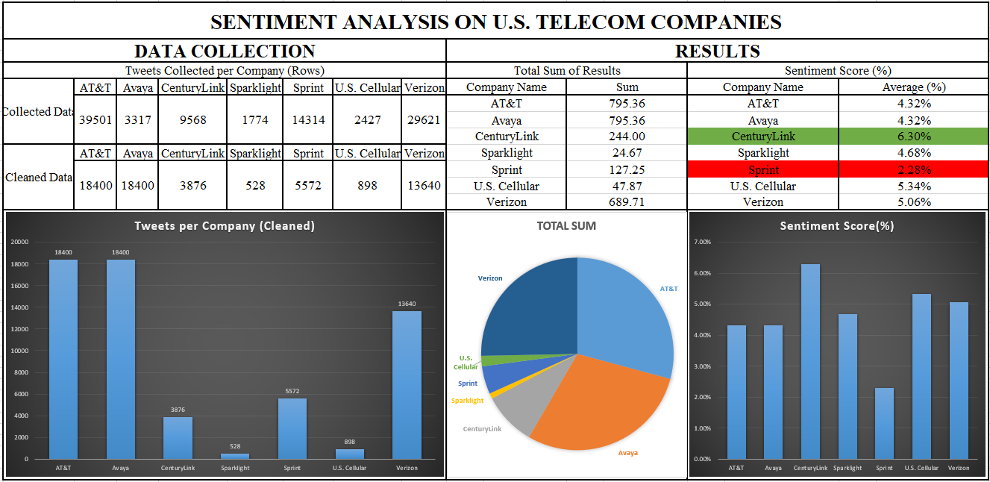
Dashboard Of Sentiment Analysis On U.S. Telecom Companies

Slide 12
Conclusion & Future Scope
4
In this we will discuss Conclusion & Future Scope of the project & How Sentiment Analysis can help Society in various way.

Slide 13
Conclusion & Future Scope
Conclusion of Project : Conclusions of this project “Sentiment Analysis of U.S. Telecom Companies” are :
Most Liked Company : Century Link
Least Liked Company : Sprint Corporation
Future Scope : Data Mining and Sentiment Analysis techniques can be used by Managers to take timely actions to predict and prevent such Customer Churn.

Slide 14
1,00,522 Tweets Collected
61,284 Tweets Cleaned
84.7%
Tweets Collected for the Analysis
Tweets Cleaned for the Analysis
Success Rate!

Slide 15
Thanks!
Any questions ?
You can find me at
@white_devil_61
sandhurohan123@gmail.com

